Slide 1
CSCI561 Fall 2017 Week 15 Discussion
Prof Sheila Tejada stejada@usc.edu
Prof Wei-min Shen shen@isi.edu
Prof Ning Wang nwang@ict.usc.edu

Slide 2
Material covered by Endterm
Covers Everything studied in class
Lectures vs Discussion vs book: what to know?
if a topic is studied in lecture/discussion and is also in the book: need to know both.
if a topic is studied in lecture/discussion only and is not in the book: know what was studied in class.
if a topic is in the book but was not covered at all in class: no need to know.
Opening the exam before you are given the go signal will result in automatic filing of a case with the office of student judicial affairs.
Cheating during the exam will result in automatic filing of a case with the office of student judicial affairs.
Continuing to write after the stop signal will result in automatic filing of a case with the office of student judicial affairs.

Slide 3
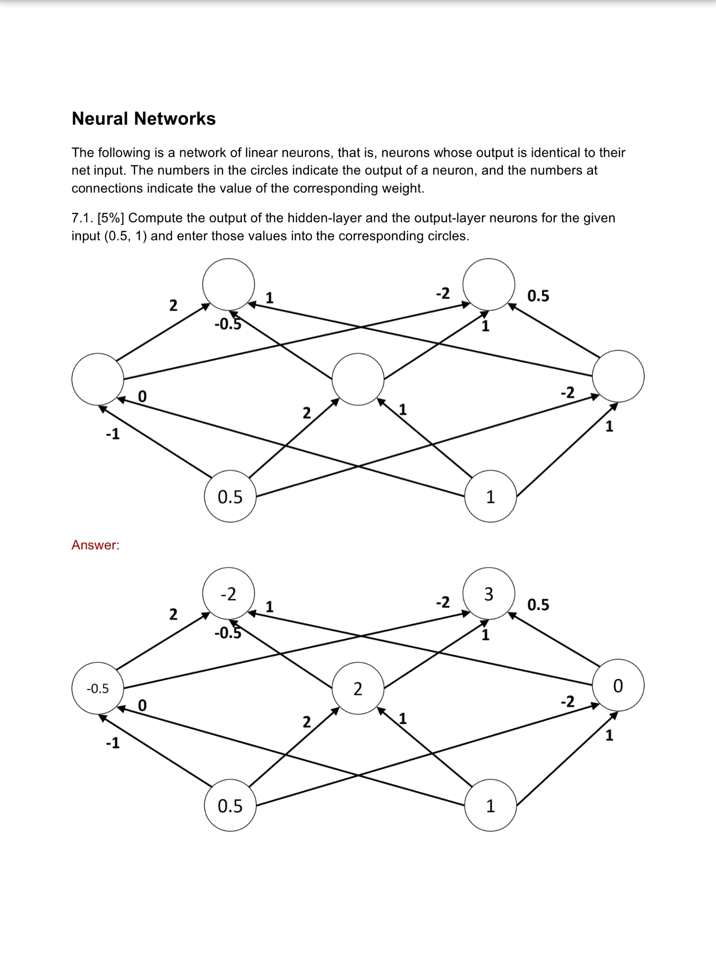

Slide 5
Short Answer
1. List 3 reasons WHY machine learning is needed?
Unknown environments
Adaptability
Lazy
Autonomous

Slide 6
Short Answer
2. What is Ockham’s razor? How is it used in neural net learning?
Bias for simplest hypothesis
Prefer fewer hidden units

Slide 7
Probability
Your doctor performs a series of medical tests. You test positive for a serious, but very rare disease. The test is 99% accurate, meaning the probability that it is positive when you do have the disease is 0.99, and the probability that it is negative if you don’t is also 0.99. The disease strikes 1 in 10,000.
What is the probability that you have the disease? Give both the formula and the value.
P(test|disease) = 0.99 P(¬test|¬disease) = 0.99
P(disease) = 0.0001
What the patient is concerned about is P(disease|test).
P(disease|test)
= P(test|disease)P(disease) = 0.99×0.0001 = .000099
P(test|disease)P(disease)+P(test|¬disease)P(¬disease) = 0.99×0.0001+0.01×0.9999 =.010098
= .000099 / .010098 = .009804
Notes:
Roughly speaking, the reason it is a good thing that the disease is rare is that P(disease|test) is proportional to P(disease), so a lower prior for disease will mean a lower value for P(disease|test). Roughly speaking, if 10,000 people take the test, we expect 1 to actually have the disease, and most likely test positive, while the rest do not have the disease, but 1% of them (about 100 people) will test positive anyway, so P(disease|test) will be about 1 in 100. More precisely, using the normalization equation from page 480:

Slide 8
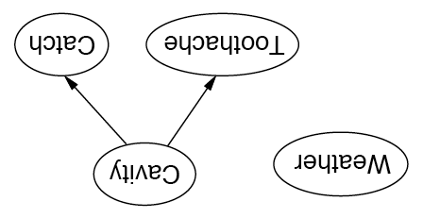
Independence in Bayesian Networks
Topology of network encodes (conditional) independence assertions:
Weather is independent of the other variables
Toothache and Catch are conditionally independent given Cavity

Slide 9
Exercise 14.1
We have a bag of three biased coins a, b, and c with probabilities of coming up heads of 20%, 60%, and 80%, respectively. One coin is drawn randomly from the bag (with equal likelihood of drawing each of the three coins), and then the coin is flipped three times to generate the outcomes X₁^{, X}₂^{, and X}₃.
a. Draw the Bayesian network corresponding to this setup and define the necessary CPTs.
b. Calculate which coin was most likely to have been drawn from the bag if the observed flips come out heads twice and tails once.

Slide 10
Exercise 14.1
With the random variable C denoting which coin {a, b, c} we drew, the network has C at the root and X1, X2, and X3 as children.
The CPT for C is:
C
x1
x2
x3
P(X|C)
^{The CPT for X}_{i} given C are the same, and equal to:

Slide 11
Exercise 14.1
The coin most likely to have been drawn from the bag given this sequence is the value of C with greatest posterior probability P(C|2 heads, 1 tails).
P(C|2 heads, 1 tails) = P(2 heads, 1 tails|C)P(C)/P(2 heads, 1 tails)
1/P (2 heads, 1 tails) is independent of C
^{∝ P(2heads,1tails|C)P(C)}
P(C) is independent of the value of C, ^{by hypothesis, equal to 1/3.}
^{∝ P(2 heads, 1 tails|C)}

Slide 12
Exercise 14.1
^{X}₁^{, X}₂^{, and X}₃ are conditionally independent given C, so for example
^{P (X}₁ ^{= tails, X}₂ ^{= heads, X}₃ ^{= heads|C = a)}
^{= P(X}₁ ^{= tails|C = a)P(X}₂ ^{= heads|C = a)P(X}₃ ^{= heads|C = a)}
^{= 0.8×0.2×0.2=0.032}
P (2heads, 1tails|C = a) = 3 × 0.032 = 0.096.
Note that we would get the same probability above for any ordering of 2 heads and 1 tails.
P (2heads, 1tails|C = b) = 0.432
P (2heads, 1tails|C = c) = 0.384
showing that coin b is most likely to have been drawn.
Alternatively, one could directly compute the value of P(C|2 heads, 1 tails).

Slide 13
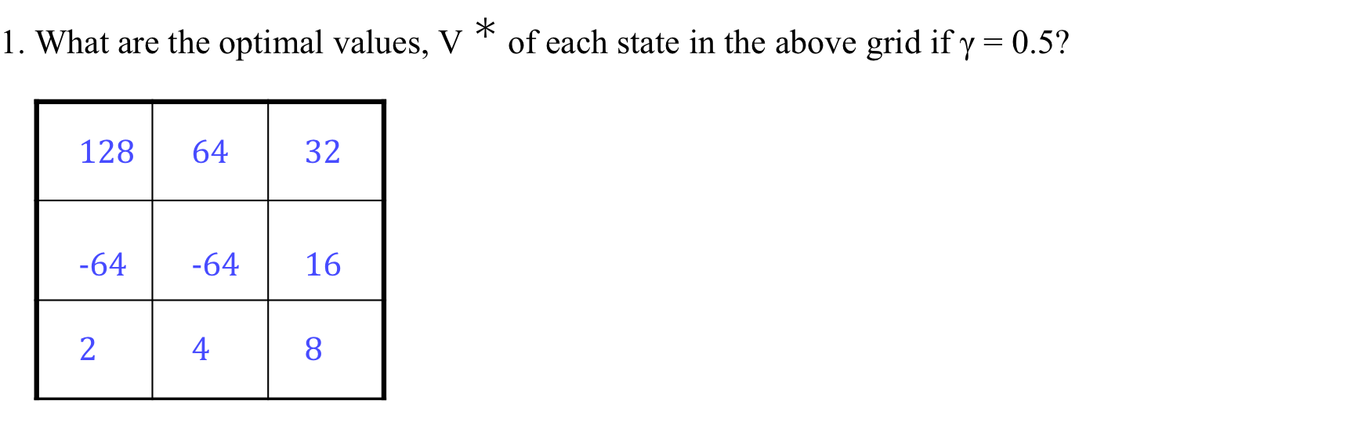
MDP
What are the optimal values and policy?

Slide 14
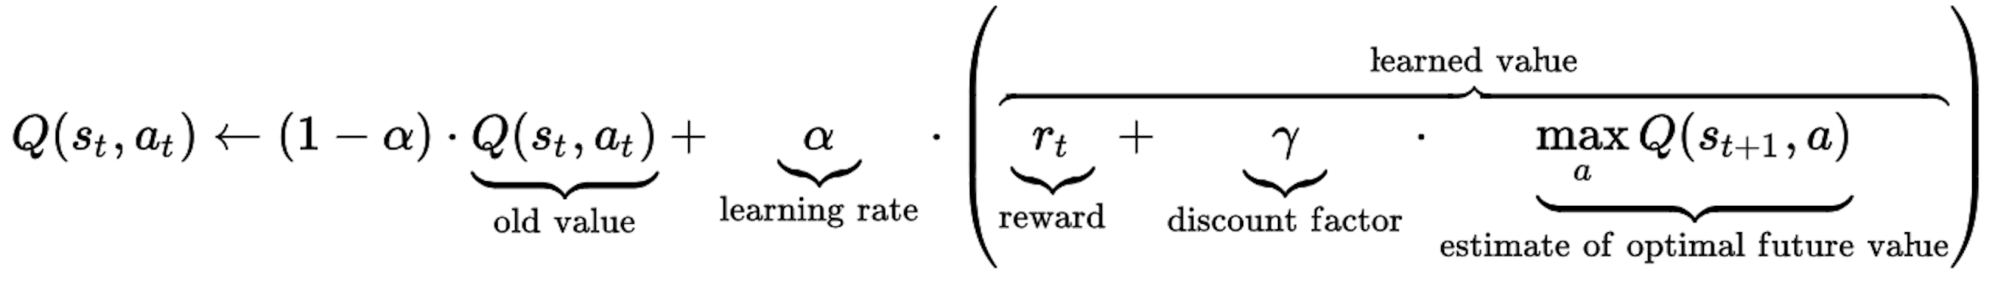
Q-Learning (Algorithm)
Initially, let Q(s, a)=0
Sample a transition and reward (s,a,s’,r)
Sample = r + γ max_{a’} Q(s’,a’)
Q(s,a) = (1-α)Q(s,a) + α*Sample
r
a’
S’
s
a

Slide 15
Q-Learning
Version of TD-learning where
instead of learning value function on states
we learn function on [state,action] pairs
[Helpful for model-free policy learning]

Slide 16
MDP
2. What are the Q-values for the last square on the second row (i.e., the one without fire)?
Q((1, 2), N) = 16
Q((1, 2), W) = −32
Q((1, 2), S) = 4
(1,2)

Slide 17
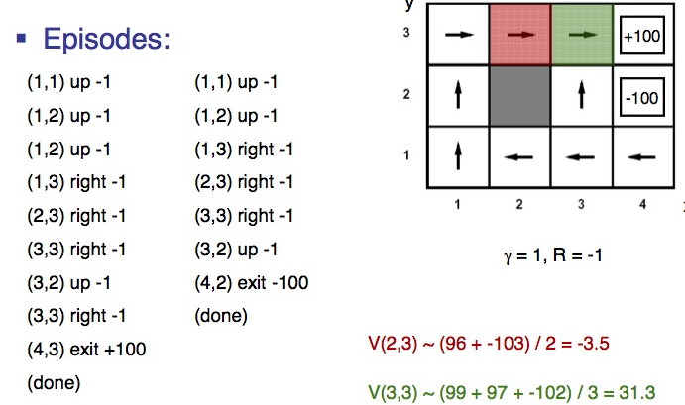
Q-Learning
Q-Learning equation is:
Q(a,s) ⇐Q(a,s) + α(R(s) + γMax_{a’εA}Q(a’,s’) – Q(a,s))
Example 1
(1,1) up 0
(1,2) up 0
(1,3) right 0
(2,3) right 0
(3,3) right 0
(4,3) exit 100
(done)
Example 2
(1,1) up 0
(1,2) up 0
(1,3) right 0
(2,3) right 0
(3,3) right 0
(4,3) exit 100
(done)
Example 3
(1,1) up 0
(1,2) up 0
(1,3) right 0
(2,3) right 0
(3,3) down 0
(3,2) right 0
(4,2) exit -100
(done)
α=0.5, γ=0.5, R=0 (except two states)
After E1
Q((2,3),R)=0 Q((3,3),R)=0, Q((4,3),exit)=50
After E2
Q((2,3),R)=0 Q((3,3),R)=25 Q((4,3),exit)=75
After E3
Q((2,3),R) =6.25 Q((3,3),R) = 37.5 Q((4,3),exit)=87.5

Slide 18
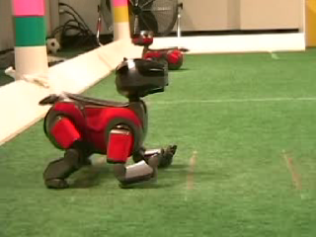
Robot walking demos

Slide 19

Google DeepMind Learn to Walk

